Slide 1
CSPS Digital Academy Version 1.0 to 2.0
Updates and Next Steps

Slide 2



Version 1.0: Foundations
Continuous consumable digital learning through busrides.ca which departments are leveraging
The Open Episode
Let’s Talk AccessAbility
Agile: Step by Step
5 myths on working openly, open by default pilot, and open source
5 accessibility myths, service design, and web accessibility testing
Defining agile, agile approaches, and designing with users

Slide 3
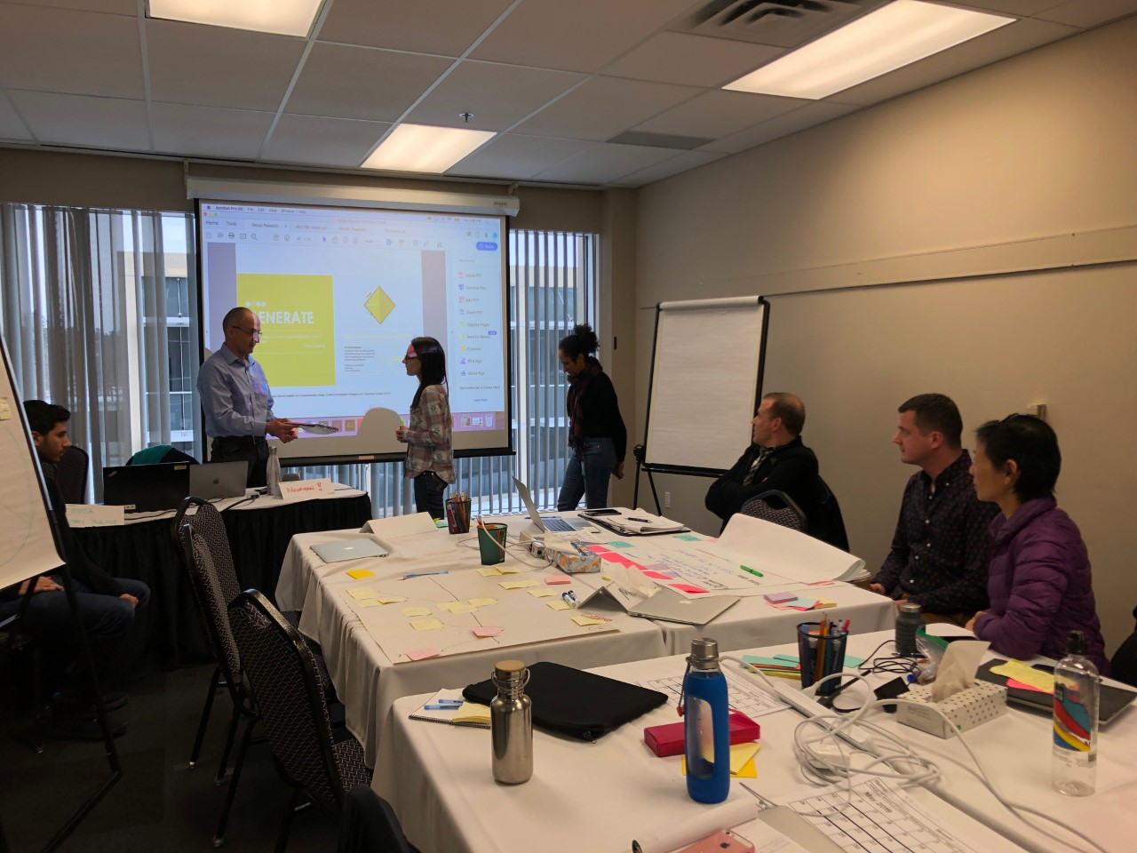
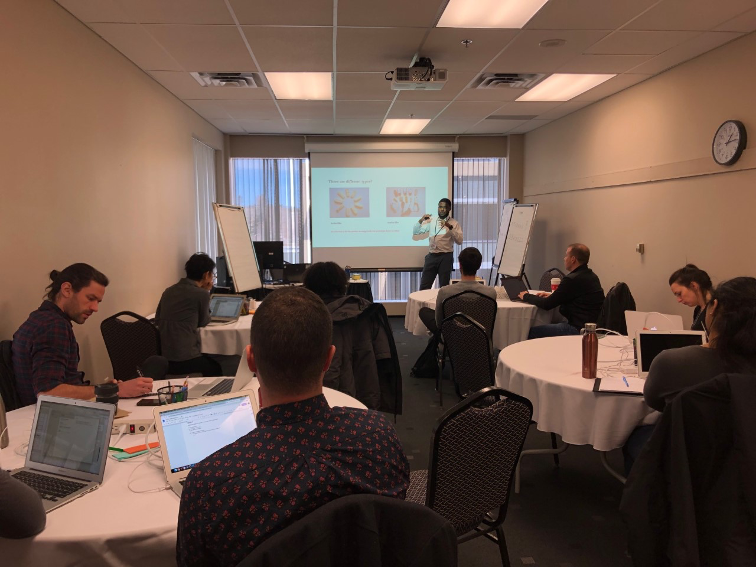
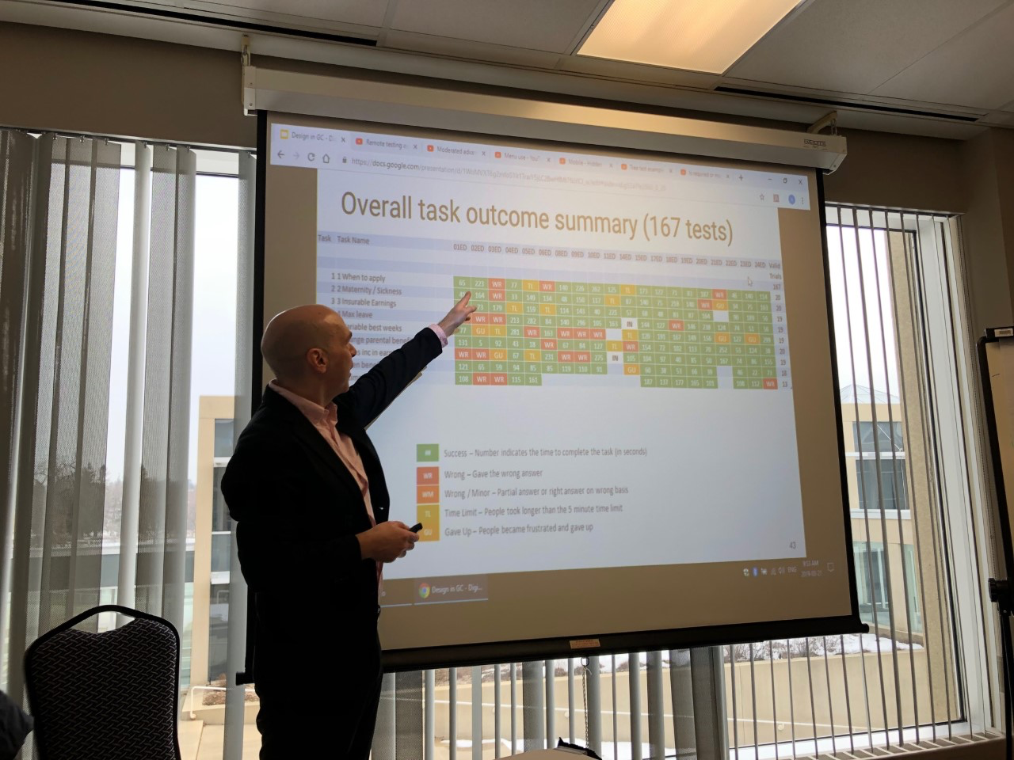
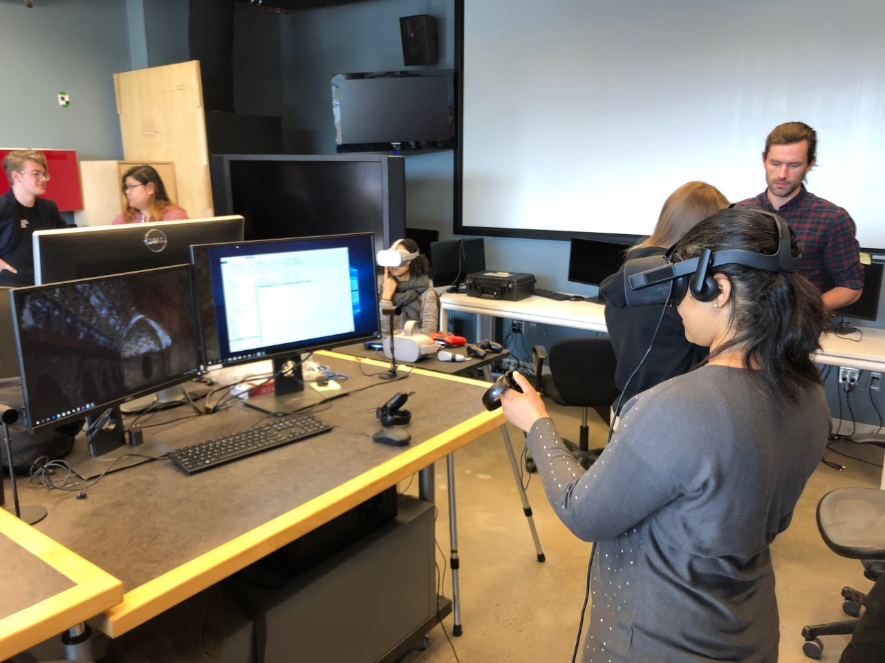
Version 1.0: Premium and Leadership
71 learners across cohorts in data, AI/ML, design, DevOps, and Digital Solutions Leaders
Across all streams: accessibility and inclusive design, user-centered design thinking, and Agile methodology
In total, 50+ learning modules representing over 400 hours of learning content to build on – or 5,500 hours of collective learning and ~12,000 when expanded to include our events reach
Topic Streams
Data
AI/ML
Design
DevOps
Digital Solutions Leadership
All streams were introduced to:
Accessibility
Agile methodology
Design thinking
Inclusive design

Slide 4

Version 1.0: Premium and Leadership
hours of collective learning
71
learners
50+
learning modules
5,500
The logistics, facility, and equipment are top notch. It is not a big deal that the course agenda is built iteratively: we are all learning as we go in this process.
I love the open lab periods and they benefit me most since I can ask for help from teaching assistants and instructors. Overall, it’s great to have actual, recognized leaders in the field teach and support the course, and I believe that carries a lot of weight.
- Mathew English, ACOA

Slide 5
Version 1.0: Practicum
Learners from across streams then formed teams to work on a business problem identified by Digital Solutions Leaders participants
The Academy provided tools (laptops and software), additional learning to meet emerging needs, and mentorship, including via the CSPS Digital Fellows
Most teams built live, working prototypes during the 3-week practicum at Bayview Yards
Practicum allowed me to think about how to reframe a problem, innovate, and transform it entirely.
The experience was not about Googling a problem in search of approaches and best practices to get the solution done on time. Instead, my team and I brainstormed and went through all possible solutions: we did not confine ourselves to things that have already been done or any constraints, and instead sought to create something new and outside of the box.
- Patrick Heard, PSPC

Slide 6








Practicum project examples
Health: Chatbot able to answer questions on the Cannabis Tracking System (CTS)
CFIA: Interactive portal that navigates the thousands of search results on commonly asked questions about CFIA regulations
ECCC: Web API allows for information about cannabis to flow between departments
PHAC: Interactive web interface for current gap areas for health data on marginalized populations
Infrastructure Canada: Mapping app for infrastructure investments
DND / PSC: Real-time evaluation and feedback on the success of training programs
ISED: A proof of concept for a data portal about Canadian businesses
NRCan: AI-enabled business intelligence and visualization tool

Slide 7
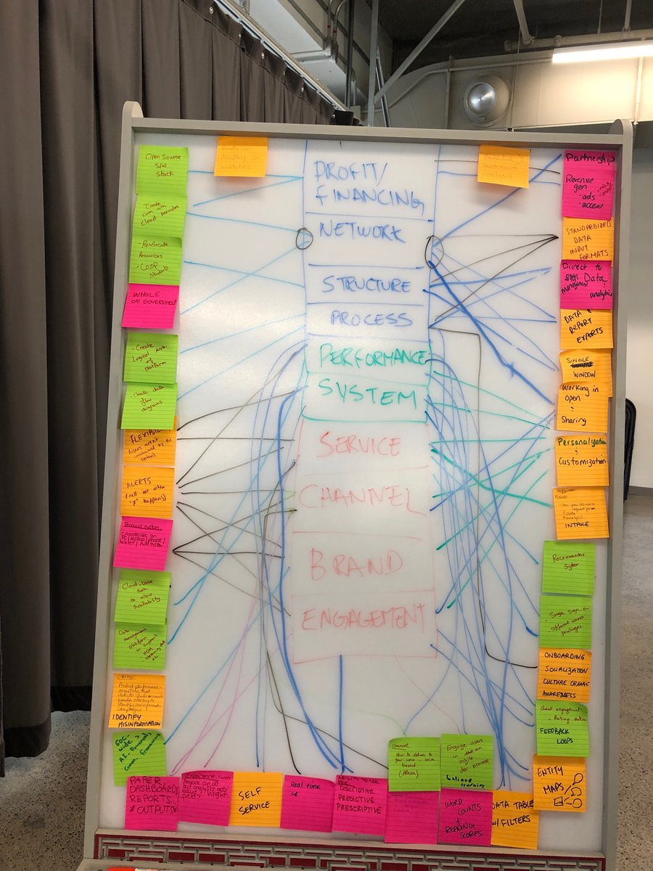
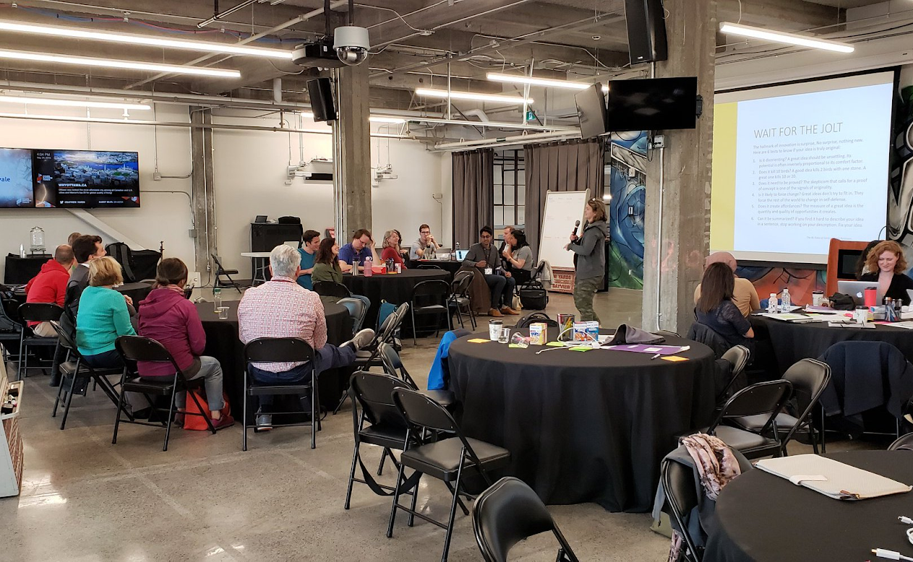
Practicum project: TBS project week 1
Solution?
Data platform that collects, cleanses, and integrates
communications/social media analytics into a single dashboard

Slide 8
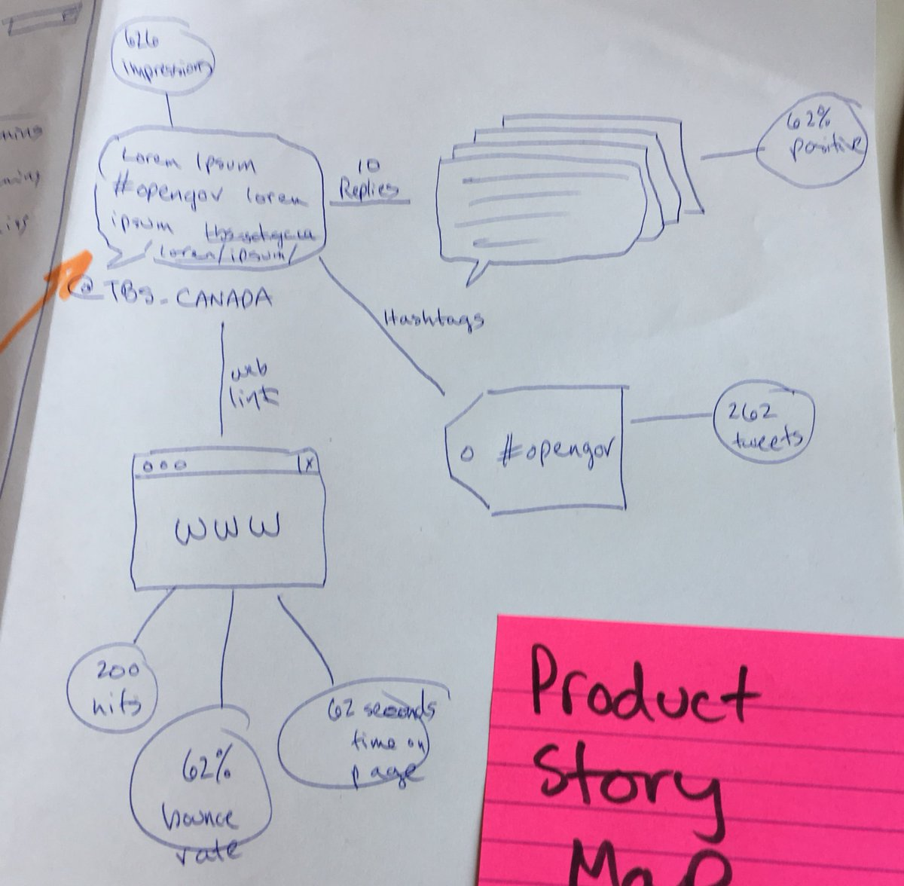
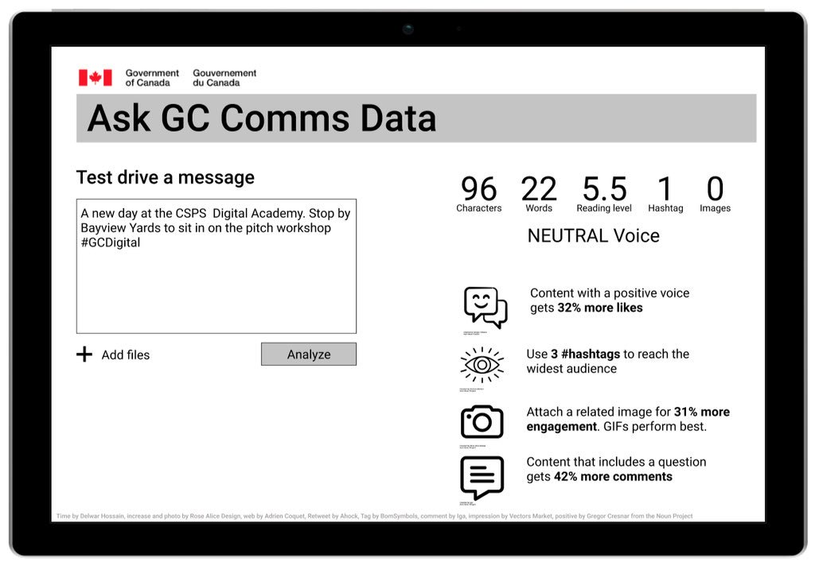
Practicum project: TBS project week 2

Slide 9
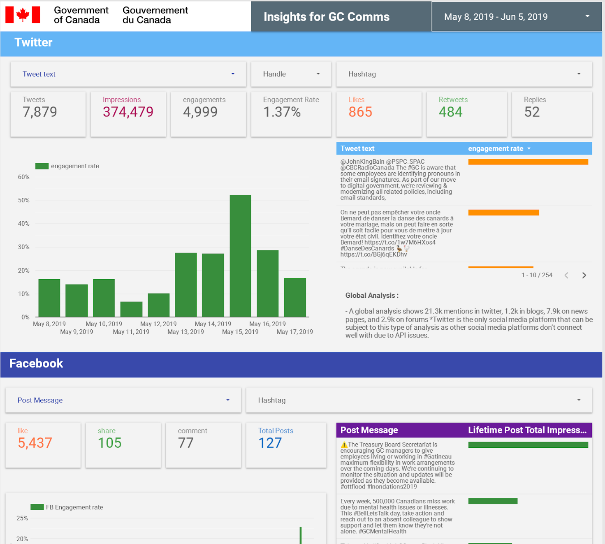
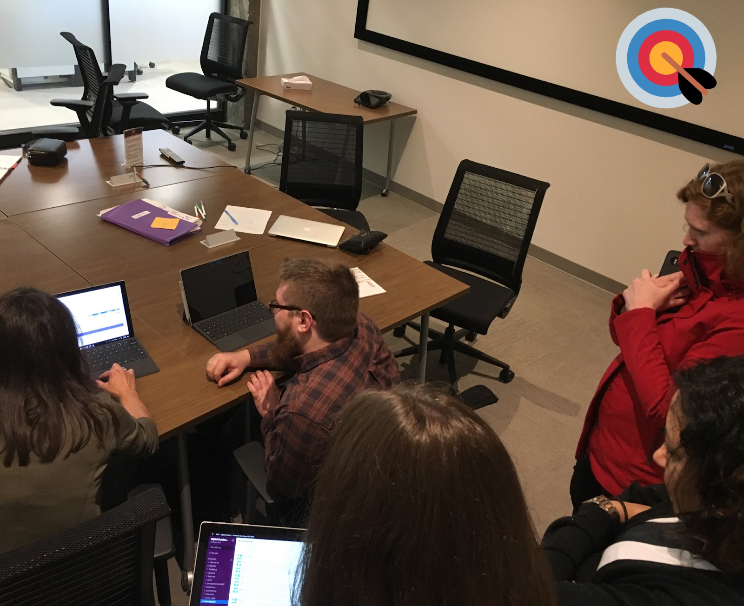
Practicum project: TBS project week 3

Slide 10
Assessment in short
Based on extensive learner feedback, discussions with departmental stakeholders and findings from the CDS Training Needs Survey, and our own onsite experience:
1
We think the prototype Premium/Leadership/Practicum model is:
on the right track with a focus on hands-on learning
on the right track in being centered on real GC problems and context
too rigid in its current format to meet departments’ many and multi-faceted needs
too rigid in its selection process
too hard to scale to both volume and geography
likely to make pockets of knowledge and skills within organizations without the supporting organizational support
In short: we think we can create a greater impact by:
Increased customization to learners’ needs
Focus on learners’ actual problems at work
Working at the team, rather than individual, learning journey
2

Slide 11










2.0 Accelerator: building team skills and mindsets
Core concepts
Problem definition
Webinars & modules
classroom
Community and aftercare
Multimedia
Coaches
Peer learning
Events
Teams with solutions leaders
Model: teams from across government gain a common foundation then go through modular, tailored learning guided by learning advisors and subject matter expert coaches
… while working on an existing project or product

Slide 12
2.0: for individuals
classroom
Webinars & modules
Community and aftercare
Peer learning
Multimedia
Coaches
Core concepts
s
Events
Individuals without teams can:
Join teams that require additional skill sets
Use online, resource-based, and/or community-focused learning
Participate in Digital Essentials, the Academy’s first anchor course

Slide 13





Academy version 2.0
Premium/Accelerator
to build specialist and leadership organizational capacity through a blend of instruction, discovery, and hands-on learning
Foundations
digital open learning and Digital 101 for all public servants
Digital CSPS
Exploring additional essentials courses in disruptive technologies, data, and more
Collaboration with CSPS Transferrable Skills and core curriculum digital throughout public sector learning and expansions in agile and design
Digital Academy
Events
including panels, seminars, networking sessions, armchair discussions, and more for all public servants
Continuous community
Continuous learning, coaching, events, engagement, recognition, communities of practice and peer learning
3

Slide 14


Updates: events
Open to all public servants through online or in-person participation
Coming Soon
September 2019 Digital Open Government Forum
October 2019 Digital Academy Meetups
October 2019 Security and Resilience in the Digital World
October 2019 Digital Academy Hackathons
Past Events
June 2019 Digital Accessibility Matters: Creating a More Inclusive Public Service
June 2019 Practicum Showcase Event
May 2019 Getting the Best out of Artificial Intelligence
April 2019 Rethinking Our Policies to Thrive in a Digital Age
April 2019 The Future of Work

Slide 15
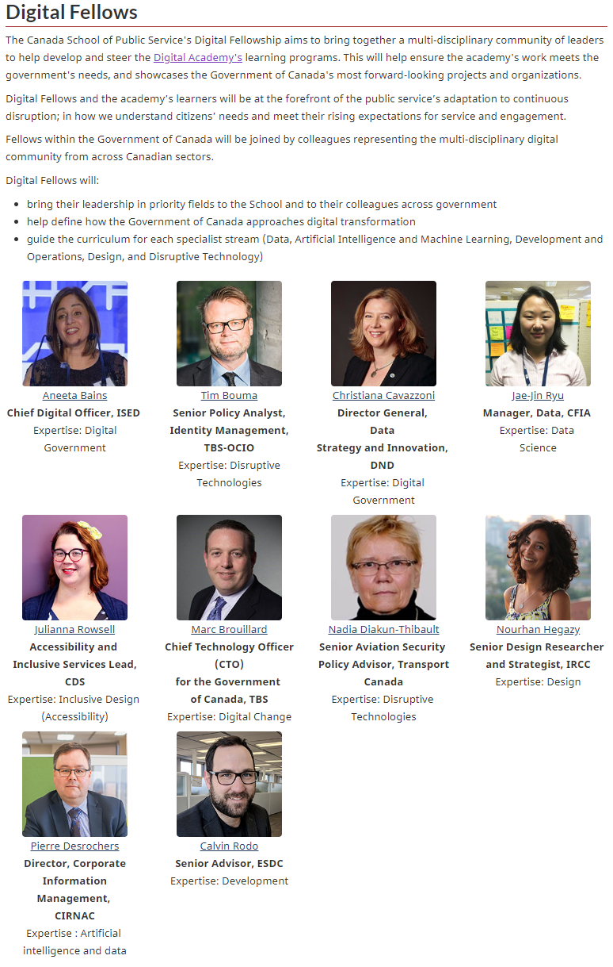
Updates: Digital Fellows
1
Internal:
Essential for design and delivery of 1.0
Conducting research on Blockchain, the ethics of AI, and how digital governance
Building community of practice around inclusive and accessible design
2
External:
Dr. Amanda Clarke surveying academic community on public/academic partnerships
Three Fellows being announced imminently
Leading Canadian experts on design, data ethics, and digital inclusion

Slide 16
Next steps
Engage and validate with Academy stakeholders, starting with you
Test biggest assumptions about 0.2 via MVPs: starting with whether departments are willing and interested to sign on to this model via a tentative call for interest and intake
Expand partner roster to allow customization:
formal via RFP
In-kind via outreach, Fellows, partnerships with departments, and collaborator SMEs
Continue to develop Digital Open Learning resources and platform
Pilot Digital Essentials course across jurisdictions
Expand support and aftercare for Academy alumni and the wider practitioner communities

Slide 17
Annex

Slide 18
1.0: building individual skills and mindsets
Model: individuals from across government enter defined, in-depth, specific learning streams

Slide 19

Academy version 0.1
Premium
to build organizational capacity
Foundations
digital open learning and Digital 101 for all public servants
Leadership
to lead and implement digital transformation
Digital Academy
Certification and aftercare
to provide access to tools and communities
Practicum
to connect leaders and practitioners around problems
3

